Slide 1
Indoor WLAN Based Localization

Slide 2
Objective
To create an indoor tracking system that can be implemented in mobile Zebra devices.

Slide 3
Benefits to Zebra
Possible applications include:
Autonomous guiding through commercial buildings (i.e. hospitals, office buildings, department stores, warehouses).
Locating lost or misplaced devices.
Tracking workers through office buildings (i.e. locating mailroom employees).
Locating injured people in case of an emergency.
Beam-forming for efficient wireless charging.
Tracking customers in a retail environment to improve analytics.

Slide 4
Overview
Offline Simulation:
Simulate room, place APs.
Calculate distances to each node in the room.
Estimate RSSI at each node based on the log-normal path loss equation.
Average the multiple estimates.
Perform convolution smoothing with a uniform kernel.
Online Simulation:
Generate sample trajectory.
At each time interval, perform minimum mean squared error analysis to make current observation.
Given our current observation and our previous estimate, form a current estimate.
Store each estimate in an array, and calculate the norm of the estimation error.

Slide 5
Proposed Method (High Level)
Perform fingerprinting of RSSI throughout proposed area.
Implement a particle filter to perform tracking based off of RSSI measurements.

Slide 6
Proposed Method (Technical)
Develop Android application which can measure the received signal strength for all available APs in an area.
Perform fingerprinting over approximately 16m².
Take 3-10 measurements at each point. Save all data, then later on take sample mean for each point.
Consider gyroscope and accelerometer data.
Load this data into Python, and form different simulation models.
Find the most accurate set of equations of motion for the system.
Classify motion as static or dynamic using accelerometer data.
Perform sequential Monte Carlo importance resampling for dynamic class, and sequential importance sampling for static class.
For the dynamic class, explore different sets of state equations.
These state equations must be obtained through experiment.
Perform field tests using the Android device, a laptop, and Python implementation.
Implement proposed algorithms in Java and deploy on Zebra devices.

Slide 7
Tools Required
Laptop.
Python.
Google.
Android device.
Android programmer.

Slide 8
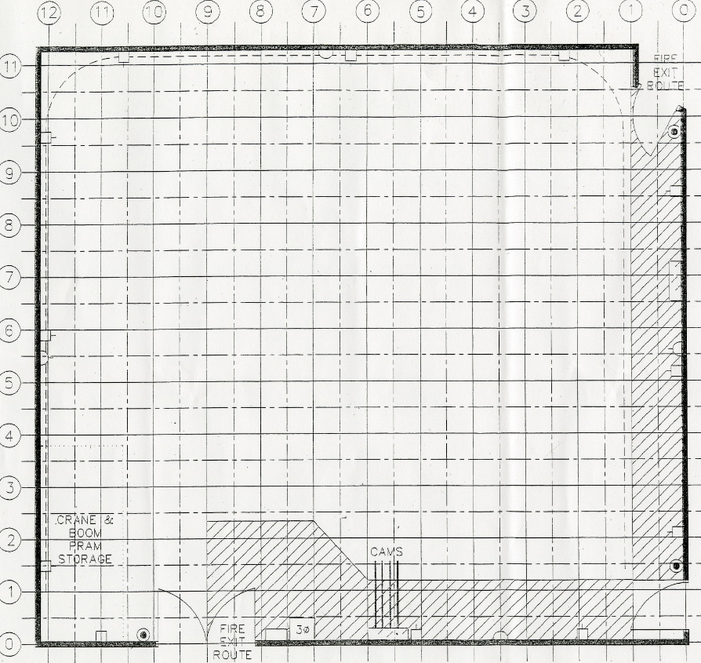
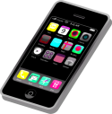

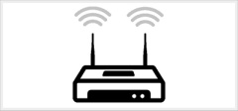
Fingerprinting Visualization
Recorded RSSI (dBm)
-65
-67
-68
…
-33
-31
-30
-58
-57
-54
-36
-34
-32
This RSSI matrix is stored in a database.
The database can be maintained in the cloud to minimize the onboard storage.

Slide 9
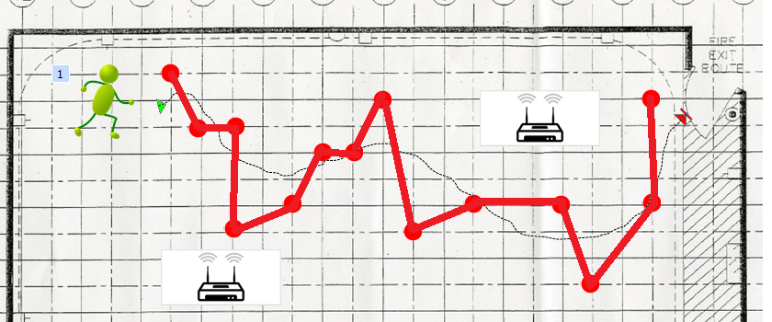
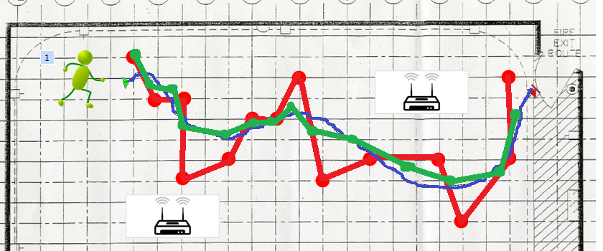

Estimation Visualization
Recorded RSSI (dBm)
-65
-67
-68
…
-33
-31
-30
-58
-57
-54
-36
-34
-32
The current position can be estimated directly based on minimizing the mean squared error of the current measurements against the fingerprint database.
Shown in red.
The SIR estimate is highly autoregressive.
Shown in green.

Slide 10
Offline Python Simulation
Place 4 APs throughout a 1400m² room.
Form grid of specified unit area throughout room.
For each node in the grid, calculate distance from each AP.
Apply log-normal path loss model to simulate RSSI from each AP at each node. Use this as fingerprint.
Iterate this process multiple times, then take the average to obtain the fingerprint.
Convolve the final fingerprint with a uniform kernel for smoothing purposes.
Simulate a trajectory.
Sample points from trajectory.
Calculate distance at each sample point from each AP.
Path Loss Model:
alpha and theta were obtained from a research paper on characterizing the path-loss model for an office building.

Slide 11
Online Python Simulation
Given the distance of the sampled points on the trajectory from each AP, simulate 3-10 RSSI measurements, then average to form final sample point RSSI.
We can average because as long as the device has moved 12.5cm (2.4G), or 6cm(5G), the noise in the path loss is considered independent and identically distributed (Puccinelli).
Find the most likely position of each point on the trajectory by minimizing the mean squared error across each node of the grid.
This position will be the observation process in the particle filter.
Use particle filter to estimate current state.
Generate two dependent Gaussian random variables ( ), using Box-Muller Transformation:
Plug these random variables into dynamics equations:

Slide 12
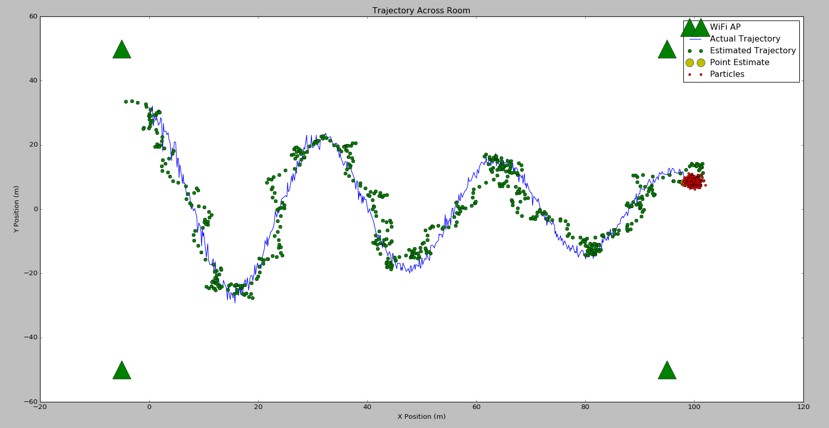
Trajectory (Weighted Sum of Particles)

Slide 13
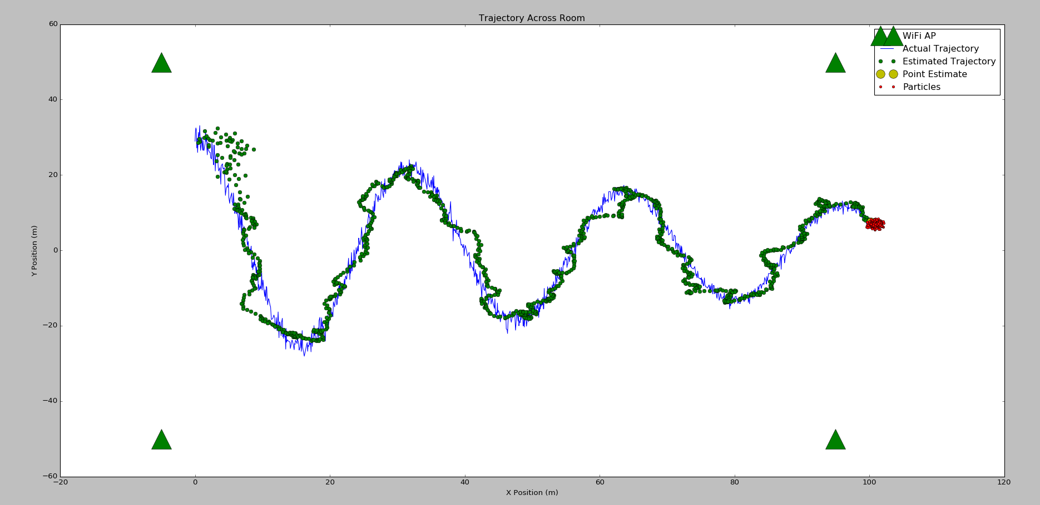
Trajectory (Weighted Sum of Particles with ARMA)

Slide 14
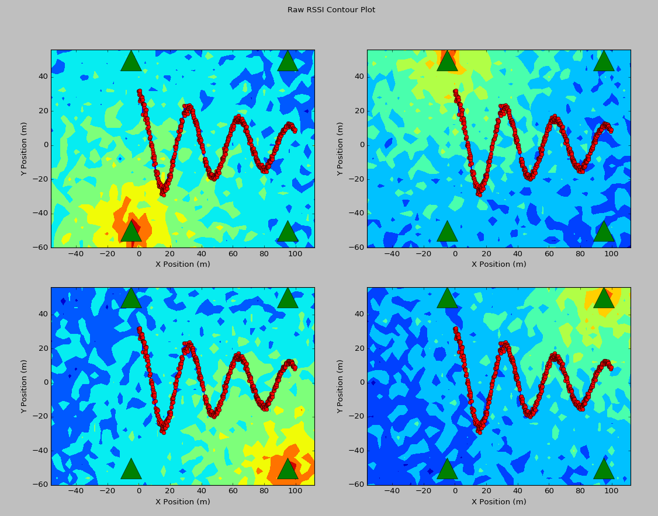
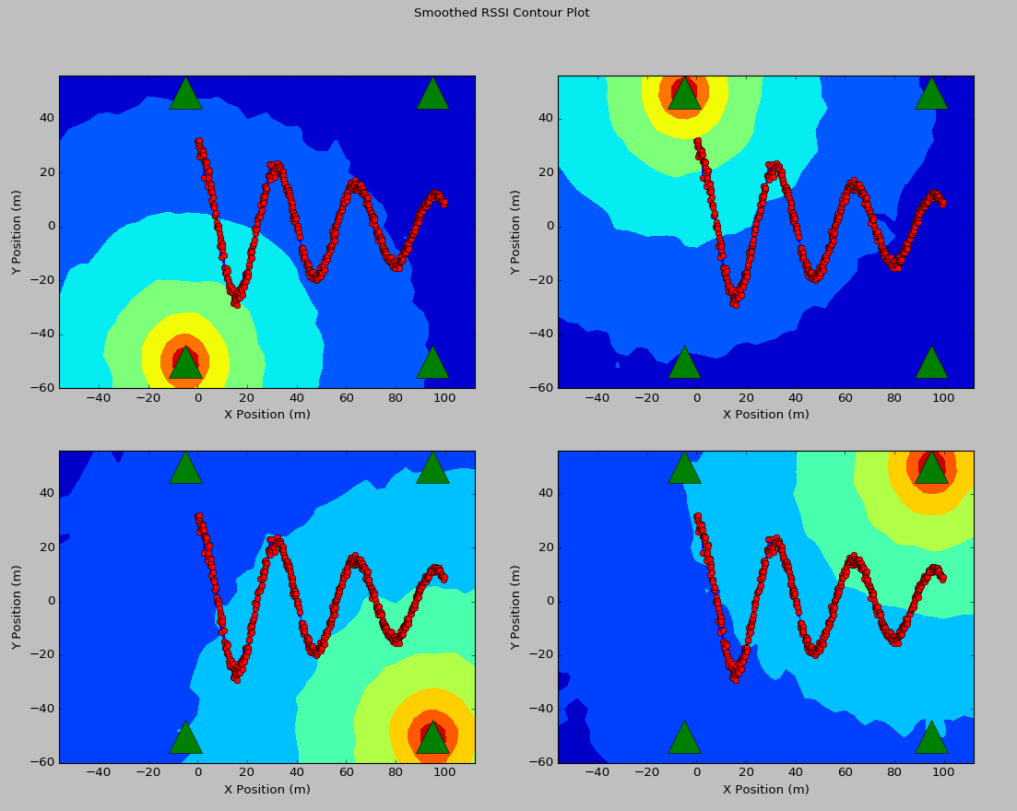
Fingerprint of Individual APs Before and After Convolution

Slide 15
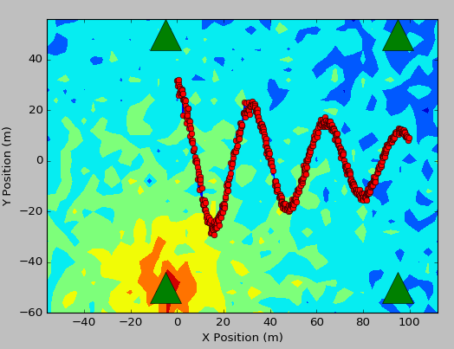
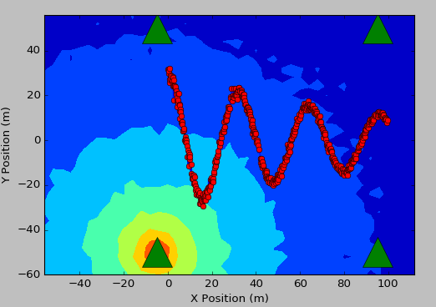
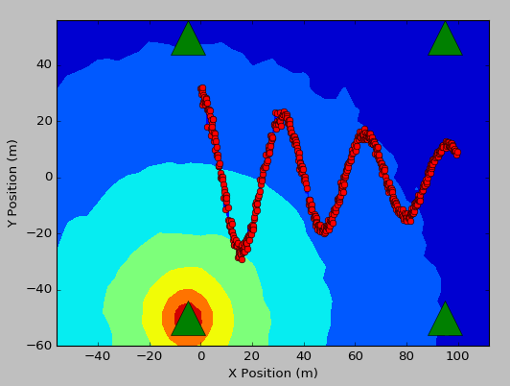
FP Comparison
Offline Averaging
Convolution Smoothing

Slide 16
Simulation Results (4 dB Standard Deviation)
Path-loss STD (dB) | Number of Online Samples | Sampling Frequency (Hz) | WS Estimate ME (m) | MAP Estimate ME (m) | WMAP Estimate ME (m) | FP Estimate ME (m) | ARMA Estimate ME (m)
4 | 3 | 8 | 3.57 | 3.58 | 3.56 | 8.83 | 4.35
4 | 3 | 16 | 2.92 | 2.93 | 2.89 | 9.34 | 2.6
4 | 3 | 32 | 2.86 | 2.87 | 2.82 | 9.26 | 2.15
4 | 3 | 64 | 2.89 | 2.9 | 2.85 | 9.2 | 2.11
4 | 5 | 8 | 3.03 | 3.06 | 3.03 | 7.15 | 3.98
4 | 5 | 16 | 2.77 | 2.78 | 2.74 | 7.2 | 2.47
4 | 5 | 32 | 2.51 | 2.53 | 2.48 | 7.17 | 1.93
4 | 5 | 64 | 2.49 | 2.52 | 2.46 | 7.19 | 1.72
4 | 10 | 8 | 2.74 | 2.77 | 2.74 | 5.39 | 3.83
4 | 10 | 16 | 2.26 | 2.3 | 2.24 | 5.13 | 1.89
4 | 10 | 32 | 2.18 | 2.23 | 2.15 | 5.11 | 1.51
4 | 10 | 64 | 2.18 | 2.23 | 2.17 | 5.14 | 1.46

Slide 17
Simulation Results (7.36 dB Standard Deviation)
Path-loss STD (dB) | Number of Online Samples | Sampling Frequency (Hz) | WS Estimate ME (m) | MAP Estimate ME (m) | WMAP Estimate ME (m) | FP Estimate ME (m) | ARMA Estimate ME (m)
7.36 | 3 | 8 | 7.06 | 7.05 | 7.05 | 19.01 | 8.15
7.36 | 3 | 16 | 4.4 | 4.41 | 4.39 | 17.91 | 4.14
7.36 | 3 | 32 | 4.28 | 4.28 | 4.24 | 17.76 | 3.78
7.36 | 3 | 64 | 4.12 | 4.13 | 4.09 | 17.56 | 3.44
7.36 | 5 | 8 | 4.01 | 4.02 | 4.01 | 13.03 | 4.92
7.36 | 5 | 16 | 4.05 | 4.05 | 4 | 14.12 | 3.94
7.36 | 5 | 32 | 3.59 | 3.59 | 3.56 | 13.43 | 2.94
7.36 | 5 | 64 | 3.49 | 3.5 | 3.46 | 13.55 | 2.79
7.36 | 10 | 8 | 3.27 | 3.29 | 3.25 | 9.02 | 4.14
7.36 | 10 | 16 | 2.89 | 2.91 | 2.88 | 9.15 | 2.71
7.36 | 10 | 32 | 2.91 | 2.93 | 2.89 | 9.37 | 2.19
7.36 | 10 | 64 | 2.91 | 2.92 | 2.87 | 9.53 | 2.11

Slide 18
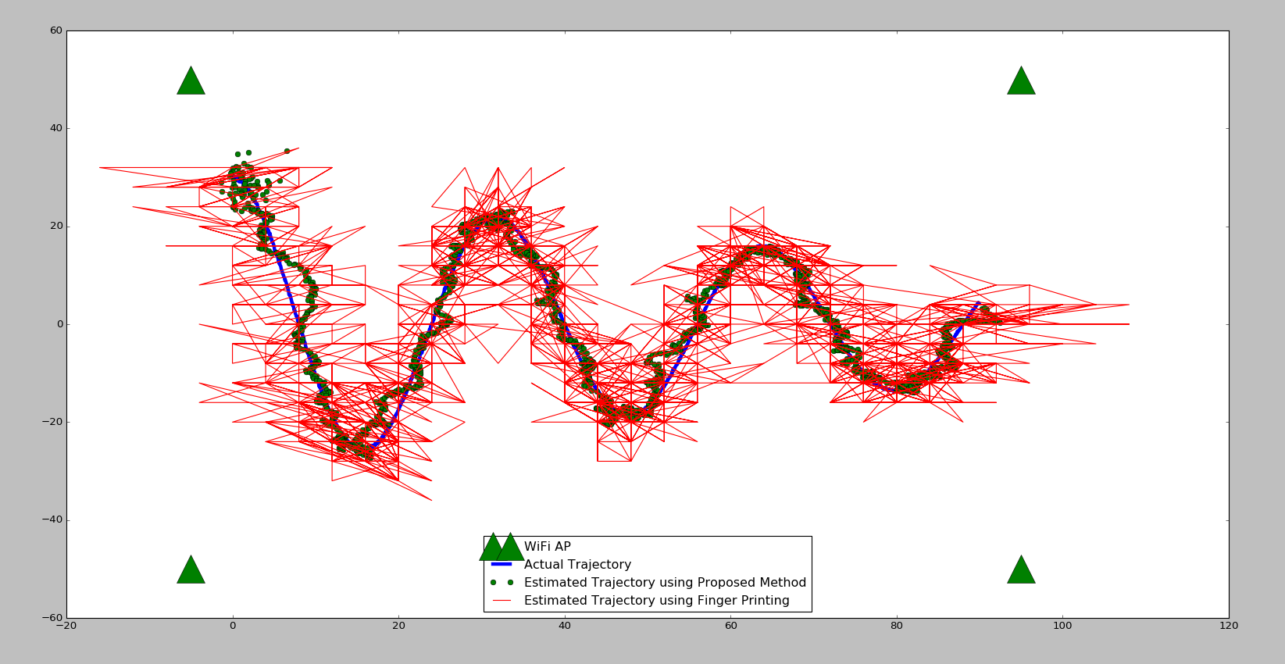

Slide 19
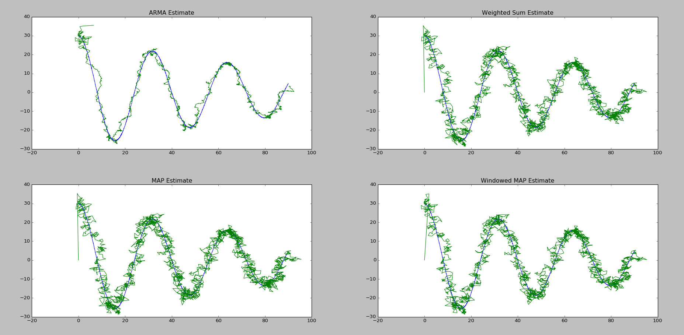

Slide 20
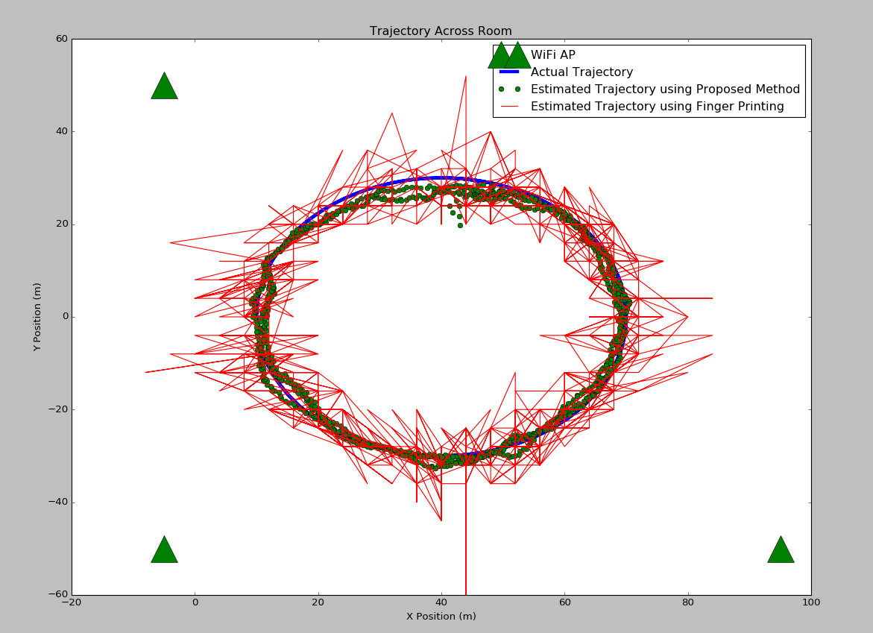

Slide 21
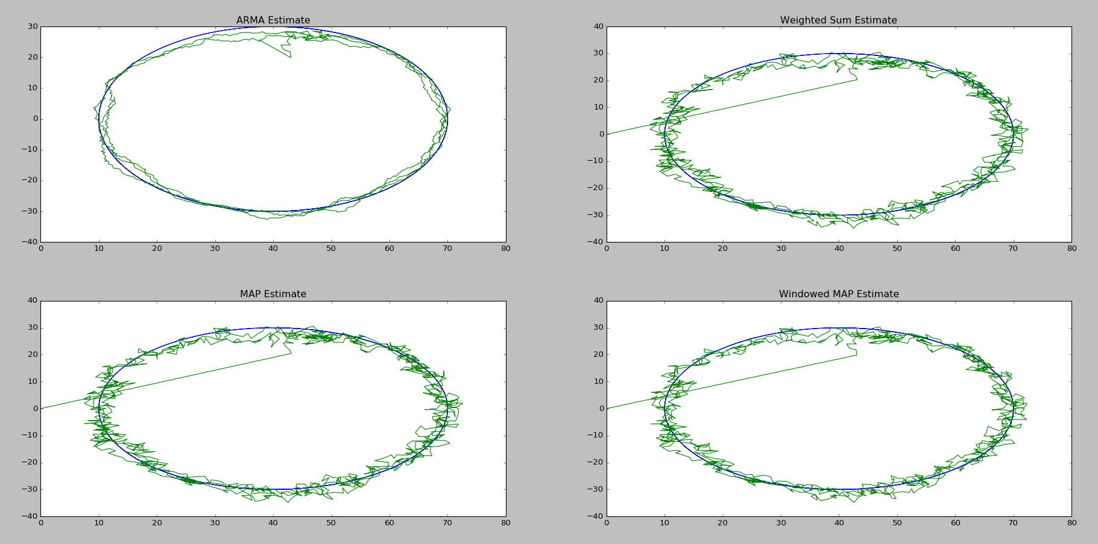

Slide 22
Advantages of WLAN Locationing
Requires no additional infrastructure on the customers end.
WiFi APs are already present in commercial buildings.
Requires no additional hardware on Zebras end.
All mobile computers already have the required hardware to perform WLAN locationing.
Easy to calibrate.
Fingerprint a location by simply navigating through the area with an application running to record RSSI, as well as current location.

Slide 23
Considerations
Can RSSI actually be modeled as an IID process?
How much computing power can we spare to use on devices?
How can we speed up RSSI sampling times?

Slide 24
Future Directions
Collecting accelerometer and gyroscopic data from the device.
This data can be combined with the standard sequential Monte Carlo importance sampling method to form a Rao-Blackwellised particle filter.
Crowd-sourcing the information to update the fingerprint maps throughout the day.
Equipping an autonomous robot with the materials to perform fingerprinting.
Using the GPU on the mobile devices to perform the estimation.
Particle filtering can be highly parallelized.
Uploading a floor-map and incorporating that to improve estimation.
Associate likelihoods with paths in offices or retail aisles.
Add points of interest (i.e. conference rooms, office locations, etc) and provide optimal routes.
Marketing the data collected from customers in retail environments to optimize product placement.

Slide 25
References
Improving Wi-Fi Based Indoor Positioning using Particle Filter based on Signal Strength, Sakib et al.
A Tutorial on Particle Filters for Online Nonlinear/ Non-Gaussian Bayesian Tracking, Arulampalam et al.
On Sequential Monte Carlo Sampling Methods for Bayesian Filtering, Doucet et al.
Modeling Signal Attenuation in IEEE 802.11 Wireless LANs, Faria et al.

